Slide 1
Optimizing Sensory Feedback using Control System-Modeling of Human-Prosthetic Interaction
Cynthia Steinhardt

Slide 2
Overview
Goal 1: Model the human-prosthetic interaction as a closed-loop system with sensory feedback
Goal 2: Control Synthesis – design feedback controller (in model)
Goal 3: Test the effectiveness of the feedback provided by this system using the APL mini VIE set up and measures of integration into human consciousness (EEG, psychophysics)
… but there are many steps along the way
Notes:
In between goal – some given some estimate from data
-feedback control design – now that have the model of these parameters different ways to measure
In test bed

Slide 3
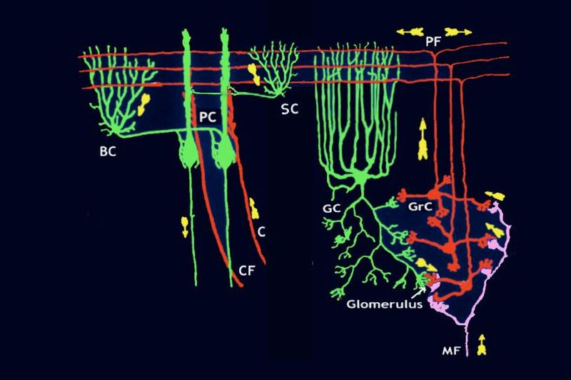
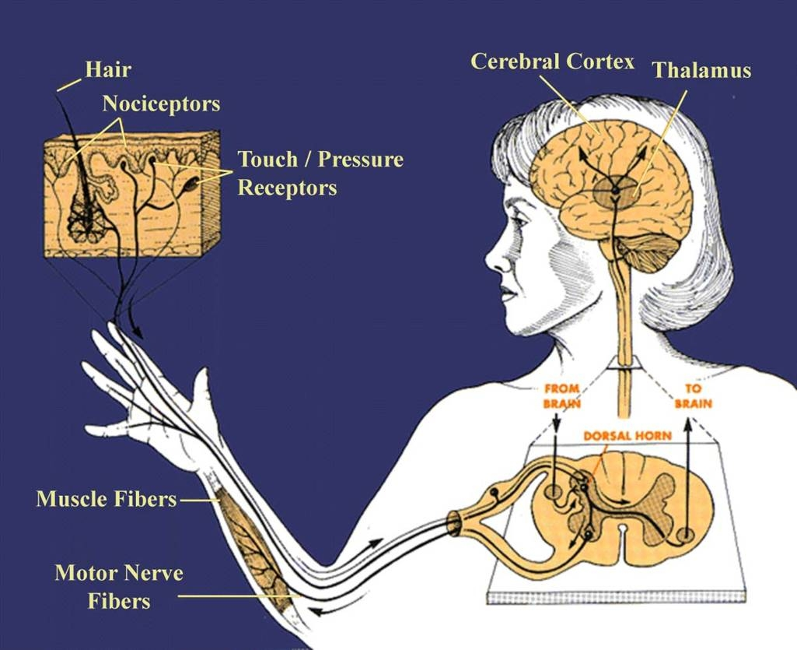
The intact system as closed-loop
The pathogenic
H
CEREBELLUM
CEREBRUM
q
r
A
M
“Hold cup”
+
-
G
S
Transfer Functions:
G = gain from climbing fibers
M = Motor cortex
A = actuator (spinal cord/muscles)
S = Spinal cord (transform of movement)
Signals:
r = reference signal
q = sensory receptor activation
Cerebellum
Notes:
First signal mossy fibers from spinal cord etc. → granule cells (200:1) with parallel fibers that pass through dendritic tree of Purkinje cells.
Purkinje cells also receive input from the inferior olivary nucleus on the contralateral side of the brainstem via climbing fibers. Although the inferior olive lies in the medulla oblongata and receives input from the spinal cord, brainstem and cerebral cortex, its output goes entirely to the cerebellum. A climbing fiber gives off collaterals to the deep cerebellar nuclei. each Purkinje cell receives input from exactly one climbing fiber
climbing fibers signal errors in motor performance (G)
Through deep nuclei to the brain

Slide 4
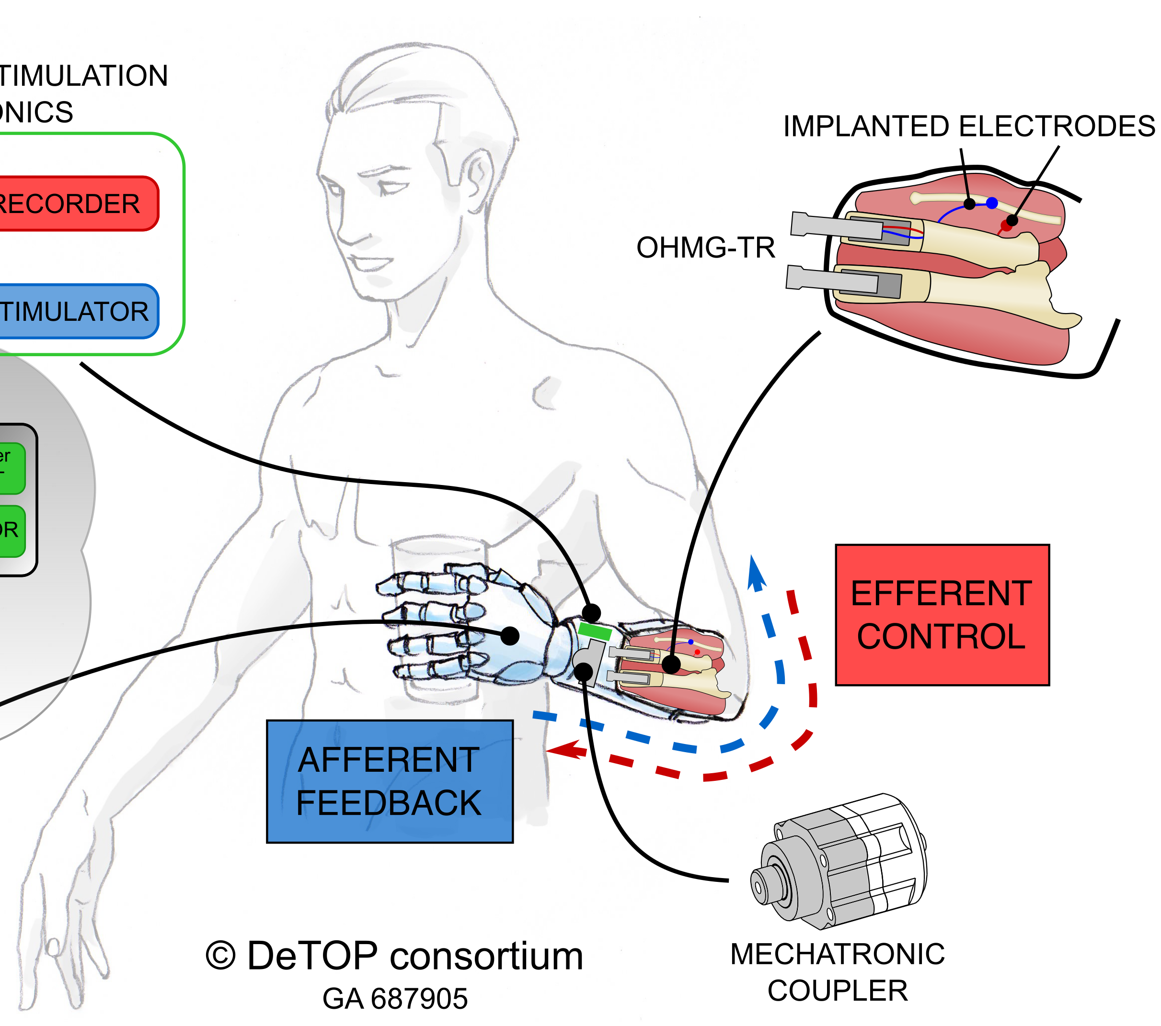
Building the closed-loop system
r
z
w
u₁
q
Use APL miniVIE Prosthetic
H
K₁
P
+
-
u₂
K₂
Transfer Functions:
H = human
P = Prosthetic
K₁ = pattern recognition
K₂ ₌ feedback loop
Signals:
r = reference signal
z = stimulation
w = EMG
q = sensor readout
H
stimulator
P
u1
w
r-u =z
recording
q
Notes:
The above diagram is a schematic of the open loop human-prosthetic system.
R – the abstract goal
Assume person tracks really well so output q looks like r **
R- u2``

Slide 5
Realizing R for Different Objects (System ID)
Actuation
signal
Sensor
readout
reference
EMG
human
prothetic
q
r
w
u₁
H
K₁
P
(movement)
noise
In the open-loop system (no feedback), r = q* measured reference signal to solve for H
To do:
Stabilize the EMG signal so it is consistent across sessions and days
Record q* = r (reference signals)
H
P
u1
w
recording
q
Notes:
Title: realize r for different objects (System Identification) – least squares estimation?
can’t measure in brain , approximate in healthy human- assume tracking correct trajectory
Use known r and q to generate data to estimate.

Slide 6
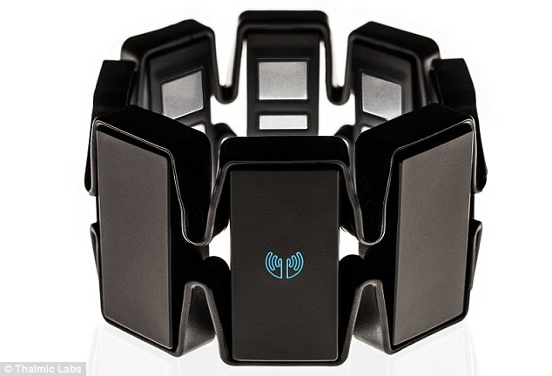
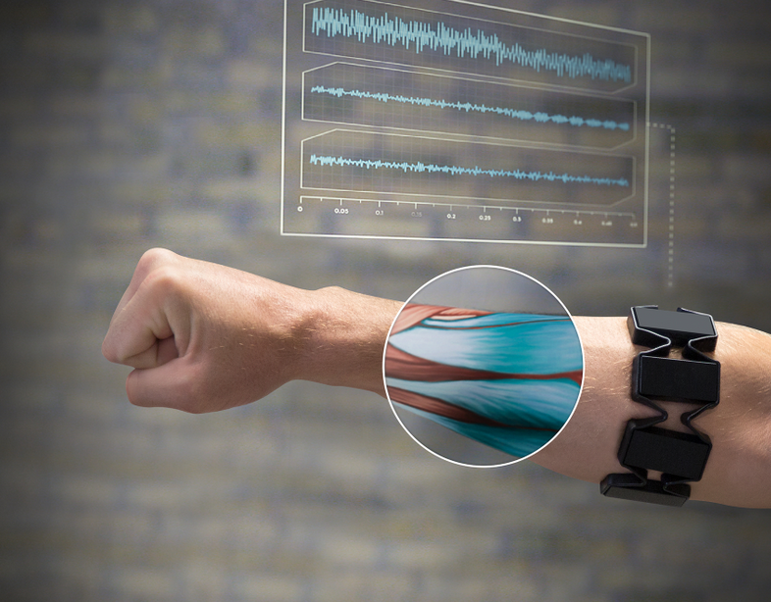
Localization of Myoband Electrode (BioCas Project)
Problem: Myoband location shifts each it is put on and then classifiers for (K1) have to be retrained.
Goal: Get a consistent w signal by creating an algorithm to interpolate results so that in any rotated position, electrodes produce the same signal.
Preliminary results gathered (4/19)
Myoband position was rotated through 0.5, 1, 2, …8 electrode positions, recording 5 motions:
open, close, supinate, pronate, tripod
Plan: work on interpolation algorithm and determine if initial training at start position can be used to classifier desired movements days or weeks later, when electrode locations are localized
Notes:
CyberGlove- with strain gages - can cover the absolute position sensors (21)

Slide 7
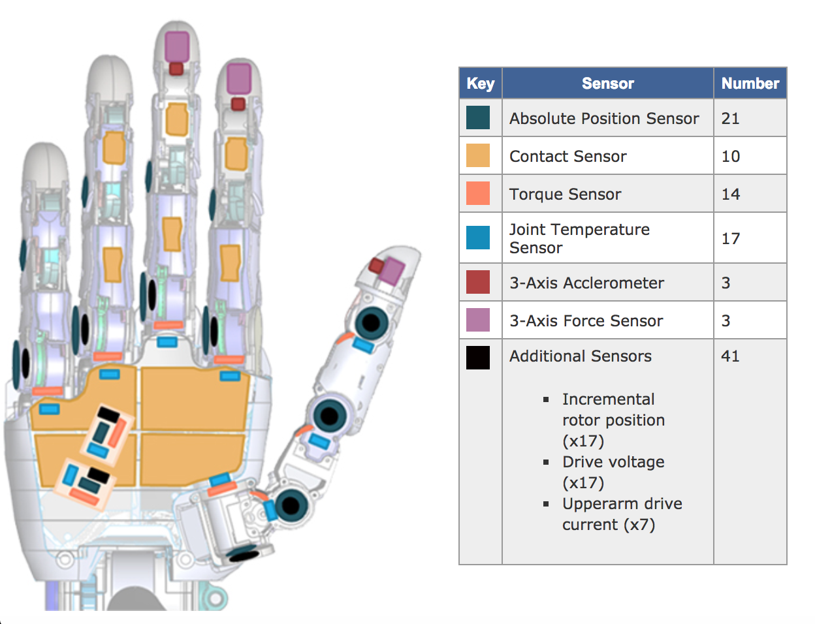
Getting a r(t) for complex motions in VR
Produce glove like APL limb:
10 contact sensors, 3-axis force sensors/3-axis accelerometer – (Luke’s sensors + algorithm choice)
21 Absolute position sensors (CyberGlove)
Record q*(t) :
Picking up different shape, density objects
Complex motions (e.g. writing the whole alphabet while holding a pen)
→ Set q* = r from recordings and derive H (e.g. EMBC paper)
Notes:
CyberGlove- with strain gages - can cover the absolute position sensors (21)
For individuated control the APL miniVIE will be used:
single finger actuation. K₂ , P defined.
Different recording inputs and sensor modeling

Slide 8
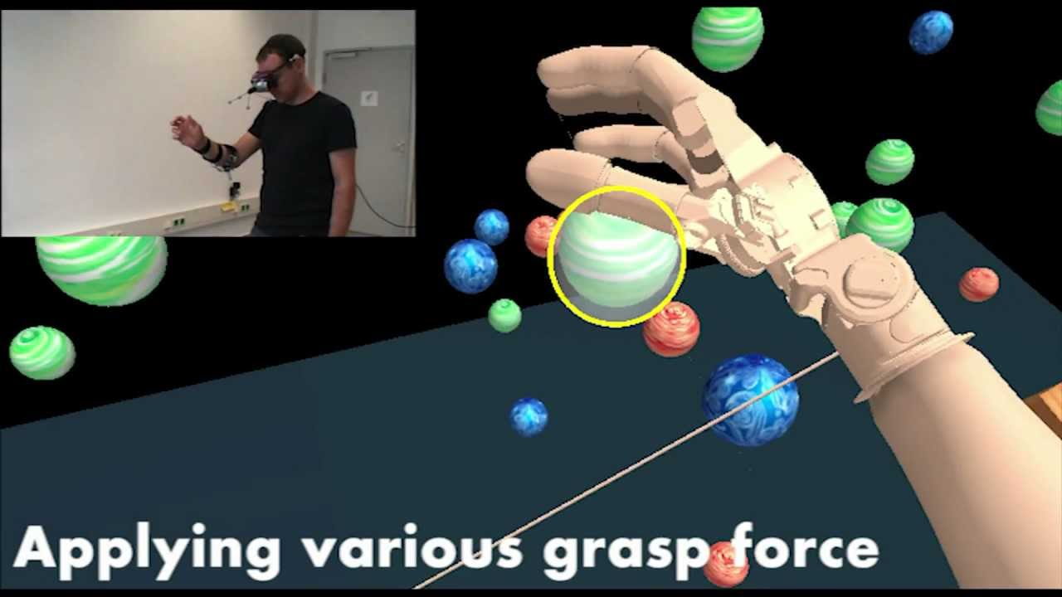

Estimating H in miniVIE
With q → r, can implement in miniVIE:
Recording with intact limb movements/interactions in miniVIE
Start from first-order, LTI, MIMO H:
$H=\frac{σ}{s+σ}$ and input step response
As arises, deal with non-linearity, etc.
Notes:
(Talk to Raina)

Slide 9

Synthesis of Feedback
r
z
w
u₂
q
H
K₂
P
+
-
noise
u₁
K₁
Objectives play a role. (e.g. may use H$∞$ model – model matching)
Objective 1: Optimize tracking
Least-squares method:
Cost function: MSE(q(t), r(t)): $\frac{1}{n}\sum_{i=1}^{n}{{\left(q_{i} −r_{i}\right)}^{2}}$ , n = # sensors
x(n+1) = Ax(n) + Bz(n); Output, w(n) = x(n) + 0 z(n).
Given w(n), z(n). → Estimate A and B.

Slide 10
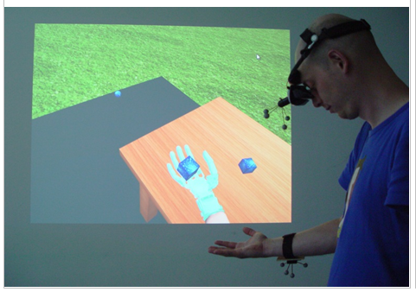
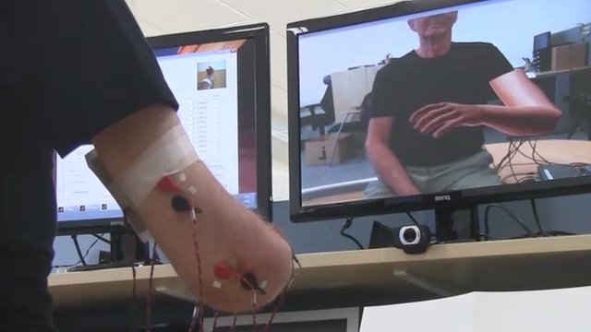
Implement and Assess Feedback
Feedback stimulation (z):
vibrotactile (parameters: amplitude, freq, spatial location)
direct stimulation (parameters: amplitude, freq, spatial location)
Constraints: painful stimuli, undetected stimuli
Subject uses virtual limb with objects in APL miniVIE/ Unity environment/objects with real-world physics
Assess goodness of reference signal replicability in subjects with intact and amputated limbs
Notes:
Once we have H, we can close the loop and design K1 and K2 as in Julia’s work.
Leave open b/c don’t know H yet*

Slide 11
Opening the H Box
Internal-state
I
reference
signal
EMG
Actuation
signal
Sensor
readout
stimulation
prothetic
r
z
w
u₂
q
H
K₂
P
+
-
u₁
K₁
Can we assess how well these feedback stimuli are integrating into the human sensory-motor system?
- To do this, may want to try to machine learn location on limb that map to different areas of lost limb.. Then can perform testing …

Slide 12
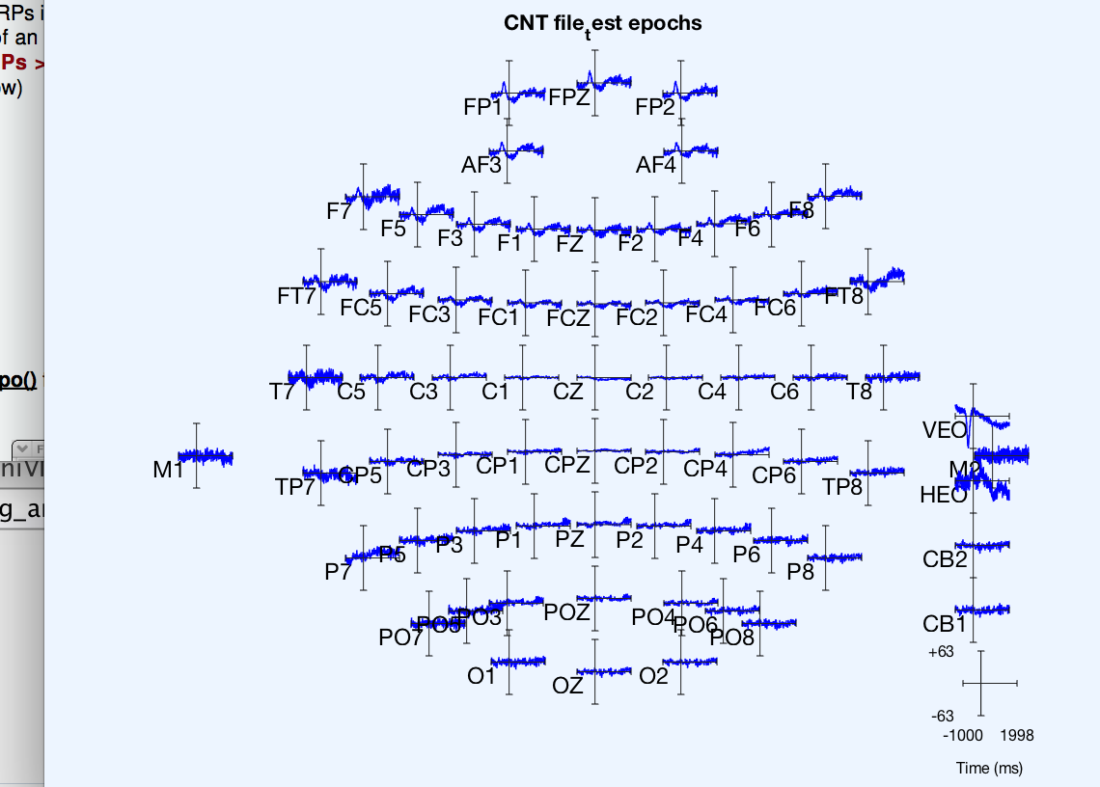
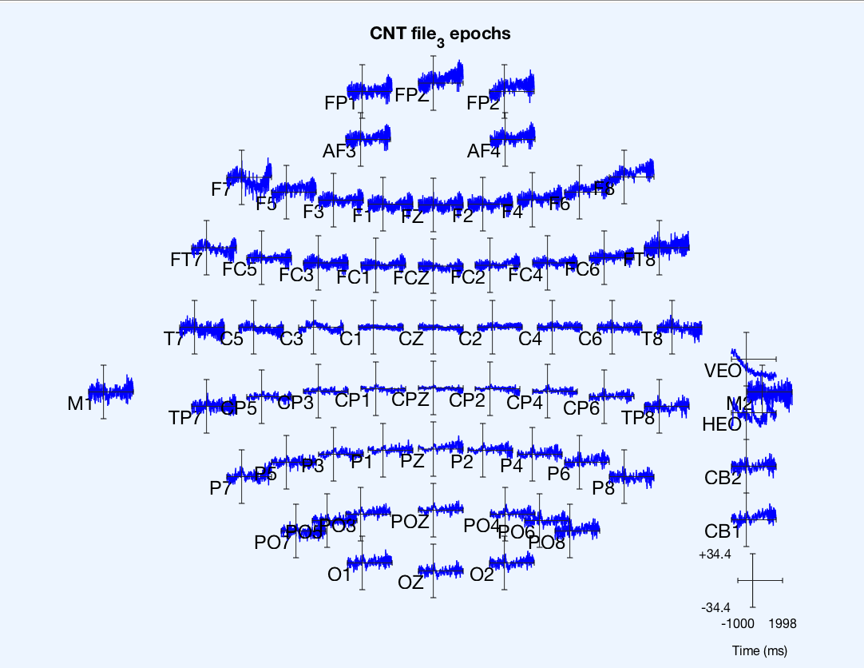
Internal State assessment
Observed different EEG evoked responses to vibrotactile feedback (Luke’s current paper)
1) at nerves mapped to different spatial locations 2) at same location with different frequencies of stimulation
Set up: EEG-recording while performing a VR task
Assess signals while interacting with objects compared to intact human
Machine learn stimulation patterns that evoke similar pattern
Questions : Psychophysics in Virtual Reality
Can we detect whether idealized control signal integrates better than neuromorphic feedback, or force-based feedback?
Does the feedback produce accurate weight assessments by the user?
Can we detect the limit to the amount of simultaneous useful feedback about different spatial locations of stimulation? (loading of perception)
Can we cause a reflex based on perception v. a conscious choice?
Can we create a sense of proprioception? Is it accurate and adjustable?

Slide 13
Experimental Set-up Questions
Initial: stimulation (z) - vibrotactile (several frequencies of stimulation, different areas of intact/amputated limb).
Should we move towards direct stimulation because it leads to more informative signaling?
How many sites are feasible with multi-site stimulation (~10 sites) - vibrotactile or electrical.

Slide 14
Timeline to 2019
BioCas/ Localization of Electrodes Project [Now – ~Oct 15 Conference] *Priorty
Start working on glove and adding sensors (As Luke makes) [Now - ~mid July, with Luke] (while Luke is around,)
Try to make reference signal recordings with glove. Preliminary recordings in an open-loop system (at least on myself) [By October 2018]
Several open loop recordings with amputees, aim for submittable results [By January 2019]
Notes:
Translational slip and grasp - local control
- coritcal loop (volitional), spinal loop (reflex) and

Slide 15
Transcutaneous electrical nerve stimulation (Electrotactile)
Frequency combination of intensity and sensation, amplitude sweeps – changing in intensity. Locational – currently limited to two channels. Could do 10, 20, etc. Current spread one issue.
Direct nerve stimulation (electrical), surgical
Notes:
No subject the same

